Slide 1
BUBBLE SORT

Slide 2
What is Sorting ? Sorting is the process of arranging data into meaningful order so that you can analyze it more effectively. we can use Discoverer to sort data as follows: sort text data into alphabetical order . sort numeric data into numerical order.

Slide 3
Bubble sort It uses simple algorithm. It sorts by comparing each pair of adjacent items and swapping them in the order. This will be repeated until no swaps are needed. The algorithm got its name from the way smaller elements "bubble" to the top of the list.

Slide 4
How Bubble Sort Works?
Bubble sort uses multiple passes through an array.
In each pass, bubble sort compares the adjacent elements of the array.
It then swaps the two elements if they are in the wrong order.
In each pass, bubble sort places the next largest element to its proper position.
In short, it bubbles down the largest element to its correct position.

Slide 5
Bubble Sort Algorithm:-
for (int i = 0; i < n - 1; i++) {
for (int j = 0; j < n - 1; j++) {
if (arr[j] > arr[j + 1]) {
temp = arr[j];
arr[j] = arr[j + 1];
arr[j + 1] = temp;
}
}
}

Slide 6

Consider the following array A
Now, we shall implement the bubble sort on this array.

Slide 7
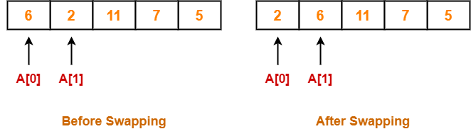
Step-01:
We have pass=1 and i=0.
We perform the comparison A[0] > A[1] and swaps if the 0th element is greater than the 1th element.
Since 6 > 2, so we swap the two elements.

Slide 8
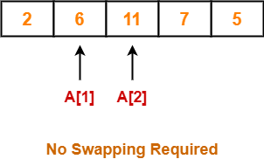
Step-02:
We have pass=1 and i=1.
We perform the comparison A[1] > A[2] and swaps if the 1th element is greater than the 2th element.
Since 6 < 11, so no swapping is required.
Step-02:
We have pass=1 and i=1.
We perform the comparison A[1] > A[2] and swaps if the 1th element is greater than the 2th element.
Since 6 < 11, so no swapping is required.

Slide 9
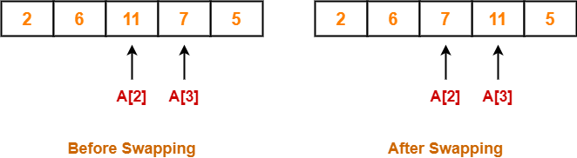
Step-03:
We have pass=1 and i=2.
We perform the comparison A[2] > A[3] and swaps if the 2nd element is greater than the 3rd element.
Since 11 > 7, so we swap the two elements.

Slide 10
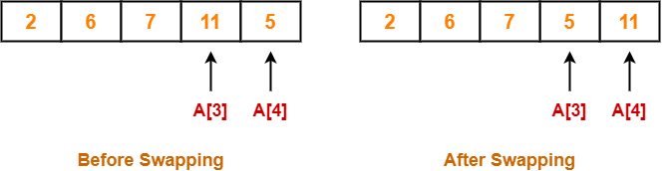
Step-04:
We have pass=1 and i=3.
We perform the comparison A[3] > A[4] and swaps if the 3rd element is greater than the 4th element.
Since 11 > 5, so we swap the two elements.

Slide 11


Step-05:
Similarly after pass=2, element 7 reaches its correct position.
The modified array after pass=2 is shown below-
Step-06:
Similarly after pass=3, element 6 reaches its correct position.
The modified array after pass=3 is shown below-

Slide 12
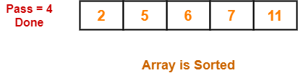
Step-07:
No further improvement is done in pass=4.
This is because at this point, elements 2 and 5 are already present at their correct positions.
The loop terminates after pass=4.
Finally, the array after pass=4 is shown below-

Slide 13
It is not that much efficient, when a list is having more than a few elements. Among simple sorting algorithms, algorithms like insertion sort are usually considered as more efficient.
Bubble sort is little slower compared to other sorting techniques but it is easy because it deals with only two elements at a time

Slide 14
Thankyou

